Slide 1
VLAN

Slide 2
Virtual LANs (VLANs)
Definition: A logical grouping of network users and resources connected to administratively defined ports on a switch.
Smaller broadcast domains
Organized by:
Location
Function
Department
Application or protocol

Slide 3
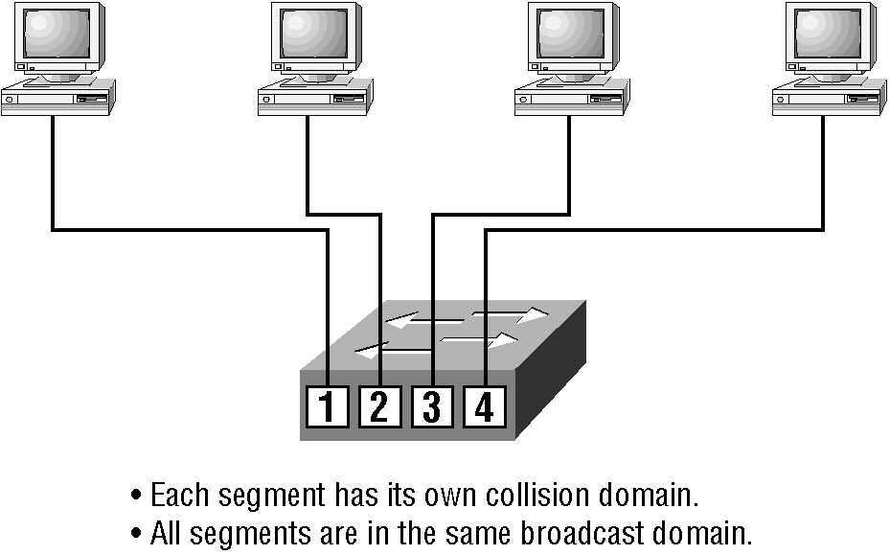
Switches

Slide 4
Features of VLANs
Simplify network management
Provides a level of security over a flat network
Flexibility and Scalability

Slide 5
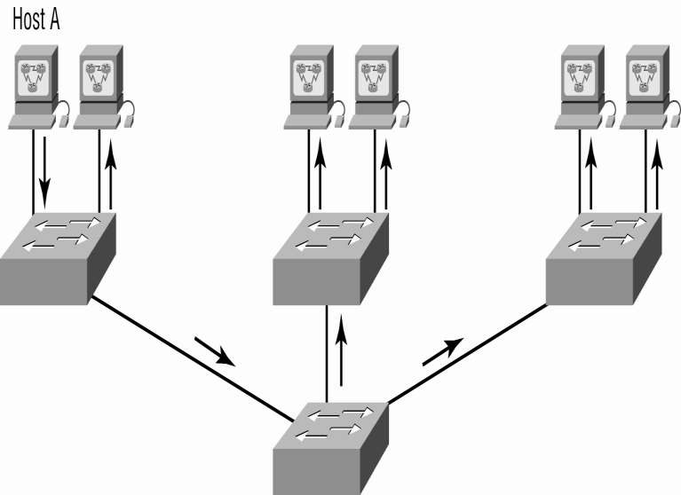
Flat Network Structure

Slide 6
Security
Flat network problems
VLANs

Slide 7
Flexibility & Scalability
Layer-2 switches only read frames
Can cause a switch to forward all broadcasts
VLANs
Essentially create broadcast domains
Greatly reduces broadcast traffic
Ability to add wanted users to a VLAN regardless of their physical location
Additional VLANs can be created when network growth consumes more bandwidth

Slide 8
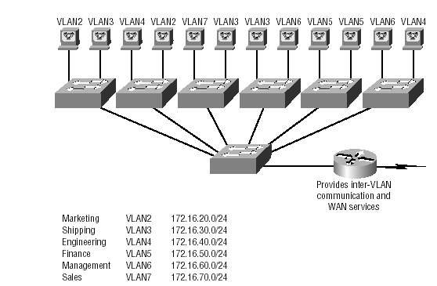
VLANs Remove The Physical Boundary

Slide 9
VLAN Memberships
Static VLANs
Typical method of creating VLANs
Most secure
A switch port assigned to a VLAN always maintains that assignment until changed
Dynamic VLANs
Node assignment to a VLAN is automatic
MAC addresses, protocols, network addresses, etc
VLAN Management Policy Server (VMPS)
MAC address database for dynamic assignments
MAC-address to VLAN mapping

Slide 10
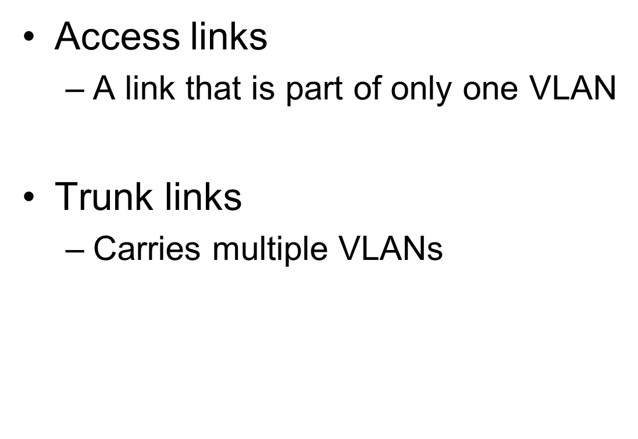
Identifying VLANs

Slide 11
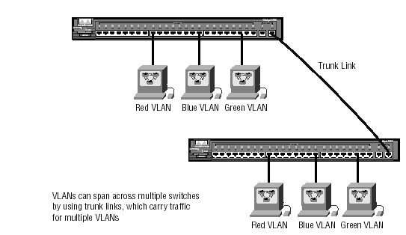
Identifying VLANs (cont.)

Slide 12
VLAN Trunk Protocol (VTP)
Purpose: to manage all configured VLANs across a switch internetwork & maintain consistency
- Allows an administrator to add, delete, & rename VLANs

Slide 13
VTP Benefits
Benefits
Consistent configuration
Permits trunking over mixed networks
Accurate tracking
Dynamic reporting
Plug-and-Play
A VTP server must be created to manage VLANs

Slide 14
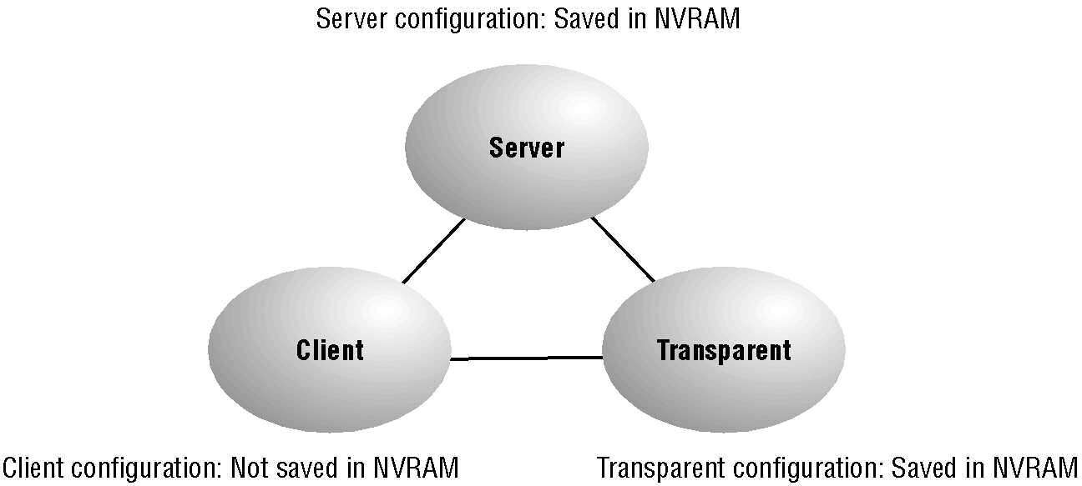
VTP Modes

Slide 15
VTP Modes of Operation
Server
Default for all Catalyst switches
Minimum one server for a VTP domain
Client
Receives information + sends/receives updates
Cannot make any changes
Transparent
Does not participate in a VTP domain but forwards VTP advertisements
Can add/delete VLANs
Locally significant

Slide 16
Configuring VLANs
Creating VLANs
Assigning Switch Ports to VLANs
Configuring Trunk Ports
Configuring Inter-VLAN routing

